Slide 1
Requirements Specification Document Generation
Process Overview and Prompts Used

Slide 2
Introduction
This presentation outlines the steps followed to generate a professional requirements specification document for a Data Engineering project.
It includes the inputs, outputs, and prompts used with AI models GPT-5 and Claude Sonnet 4.

Slide 3
Step 1: Generate Transcript
Input: 2 text files containing sample transcripts
Output: Transcript content showing realistic communication between client and consultants
AI Used: GPT-5
Prompt: Generate a transcript (refer to the attached files as templates) such that: imagine my company, Icube Consultancy Services Inc. is at the client location to learn about the requirements, ask questions, discuss resources, highlight gaps, feasibility, roles, and responsibilities. Based on this, generate a realistic transcript like a real requirements gathering interaction.

Slide 4
Step 2: Generate Requirements Specification Document
Input: Transcript document + BRS template
Output: Requirements Specification Document (.md file)
AI Used: Claude Sonnet 4
Prompt: Read and understand the transcript attached, which comes from an interaction between the client and consultants. Using the attached template, build a professional requirements specification document that includes all important aspects from a Data Engineering perspective.

Slide 5
Summary
This process demonstrates how AI can be used to automate the creation of professional documentation.
GPT-5 was used to simulate realistic client-consultant communication.
Claude Sonnet 4 was used to generate the final requirements specification document.

Slide 6
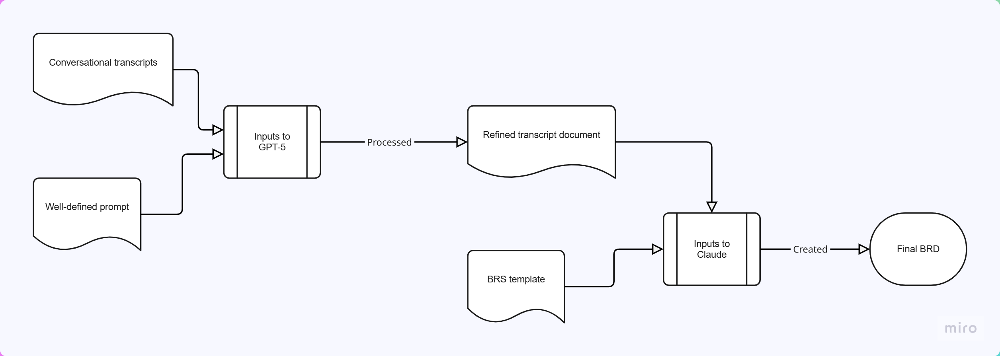
Visual Flow Diagram

